Slide 1
Transfer Learning & Transformers
Stefan Dumitrescu

Slide 2
Workshop Outline
What is an embedding?
How Word2Vec works
A few words about Transformers
The notion of Transfer Learning
A quick code walkthrough

Slide 3
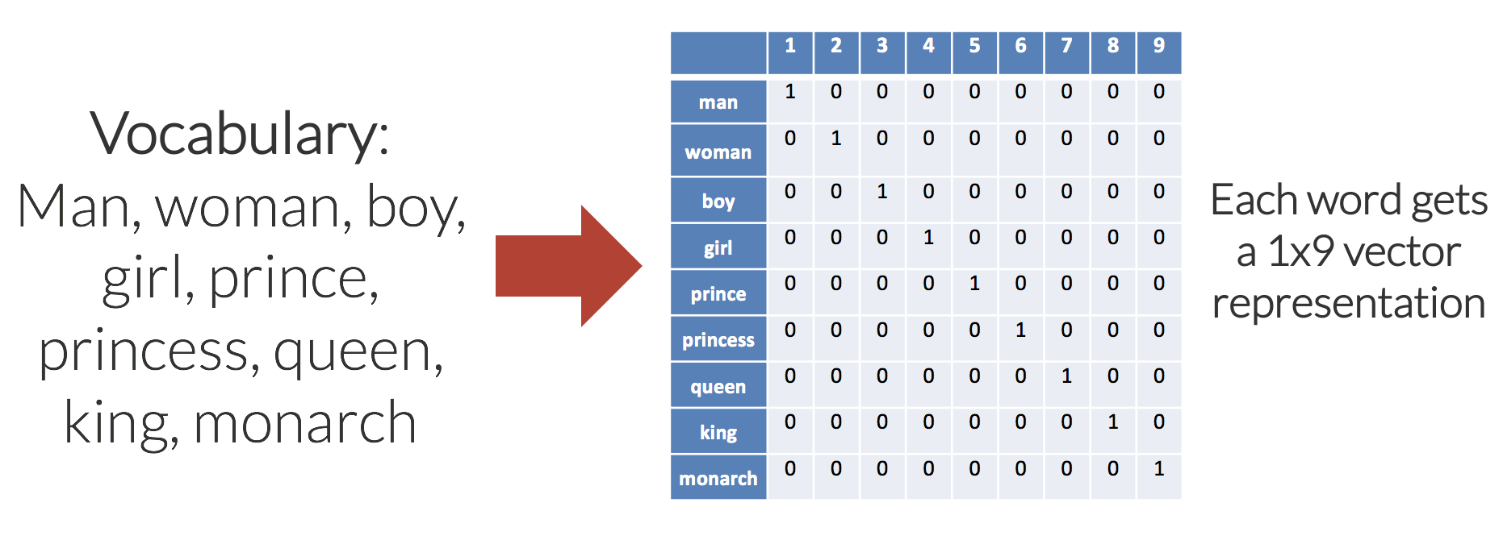
What is an embedding?
How do we represent words, in the context of a neural network?
One-hot representation vs dense representations
Notes:
There’s a few key characteristics to a set of useful word embeddings:
Every word has a unique word embedding (or “vector”), which is just a list of numbers for each word.
The word embeddings are multidimensional; typically for a good model, embeddings are between 50 and 500 in length.
For each word, the embedding captures the “meaning” of the word.
Similar words end up with similar embedding values.
The number of dimensions (columns in this case), increases linearly as we add words to the vocabulary. For a vocabulary of 50,000 words, each word is represented with 49,999 zeros, and a single “one” value in the correct location. As such, memory use is prohibitively large.
The embedding matrix is very sparse, mainly made up of zeros.
There is no shared information between words and no commonalities between similar words. All words are the same “distance” apart in the 9-dimensional (each word embedding is a [1×9] vector) embedding space.

Slide 4
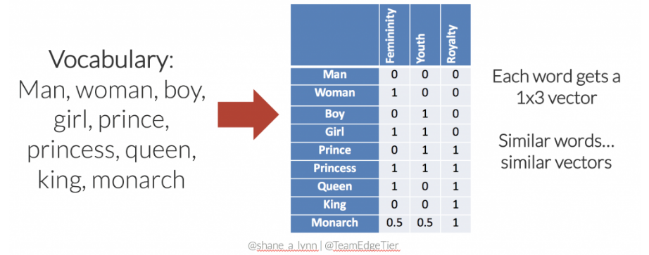
What is an embedding?
How do we represent words, in the context of a neural network?
One hot representation vs dense representations
Notes:
The set of embeddings is more efficient, each word is represented with a 3-dimensional vector.
Similar words have similar vectors here. i.e. there’s a smaller distance between the embeddings for “girl” and “princess”, than from “girl” to “prince”. In this case, distance is defined by Euclidean distance.
The embedding matrix is much less sparse (less empty space), and we could potentially add further words to the vocabulary without increasing the dimensionality. For instance, the word “child” might be represented with [0.5, 1, 0].
Relationships between words are captured and maintained, e.g. the movement from king to queen, is the same as the movement from boy to girl, and could be represented by [+1, 0, 0].

Slide 5
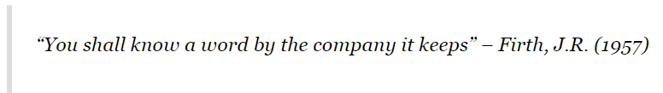
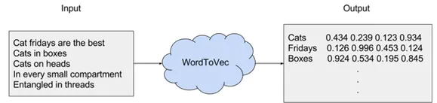
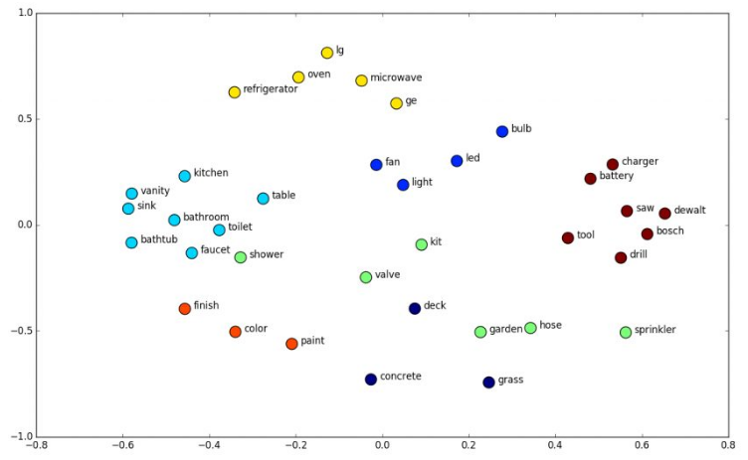
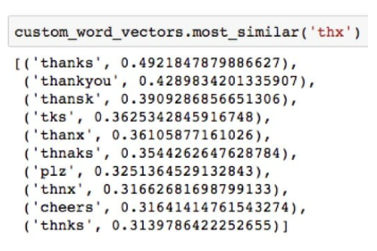
Welcome Word2Vec

Slide 6
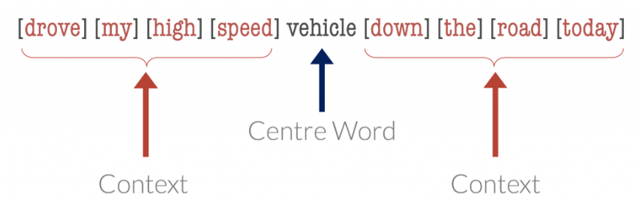
Welcome Word2Vec

Slide 7
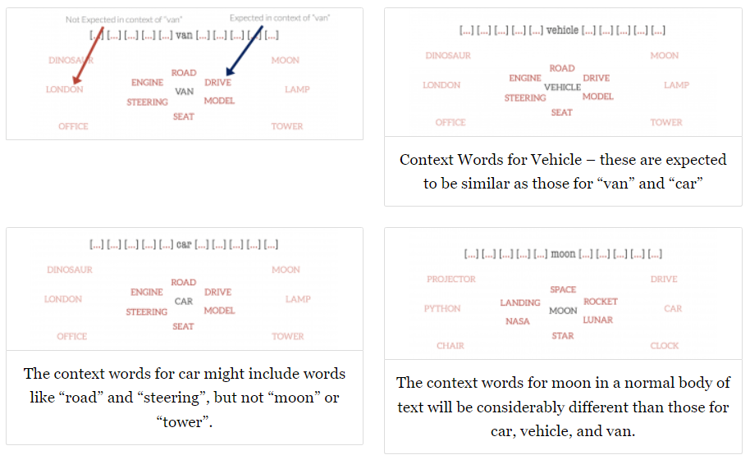
Welcome Word2Vec
Intro to Word Embeddings and Vectors for Text Analysis. (shanelynn.ie)

Slide 8
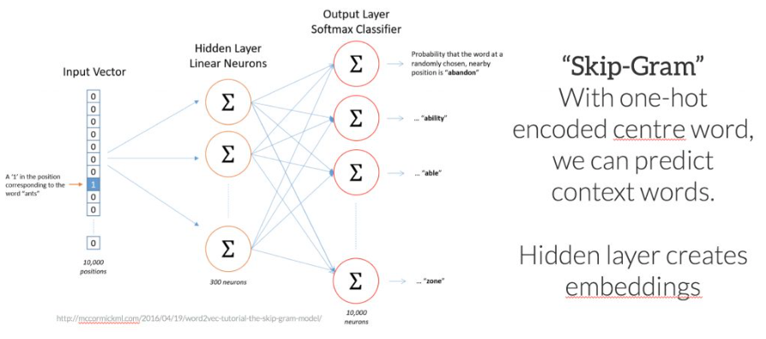
Word2Vec - SkipGram

Slide 9
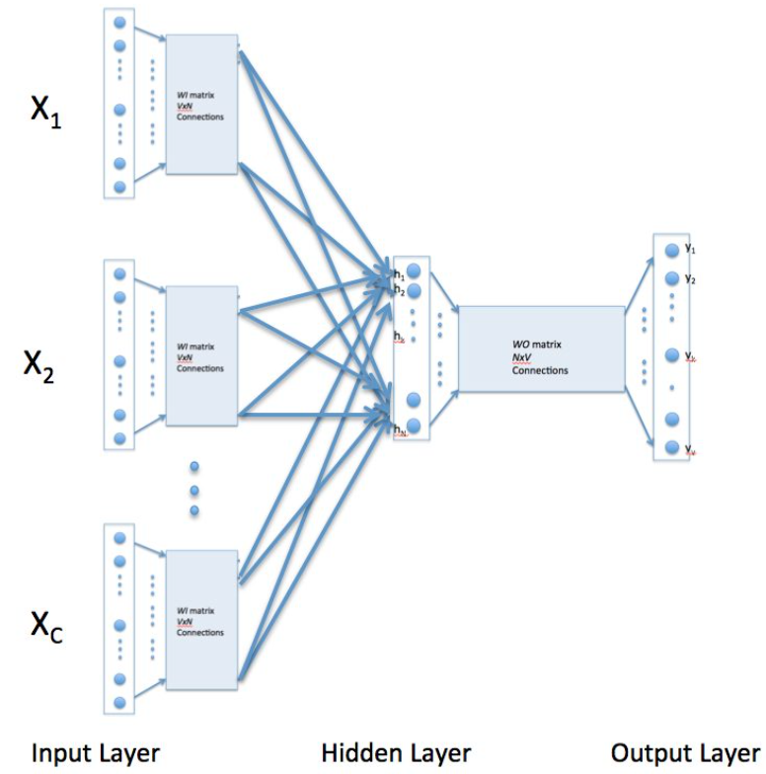
Word2vec - CBoW
Skip-gram: works well with a small amount of the training data, represents well even rare words or phrases.
CBOW: several times faster to train than the skip-gram, slightly better accuracy for the frequent words.

Slide 10

Now what?
We have good representations for words.
… do we?
NO, the representations are fixed!
… how do we use them to encode an entire sentence?
NO AGAIN, averaging fixed embeddings in a BoW manner loses semantic meaning.

Slide 11
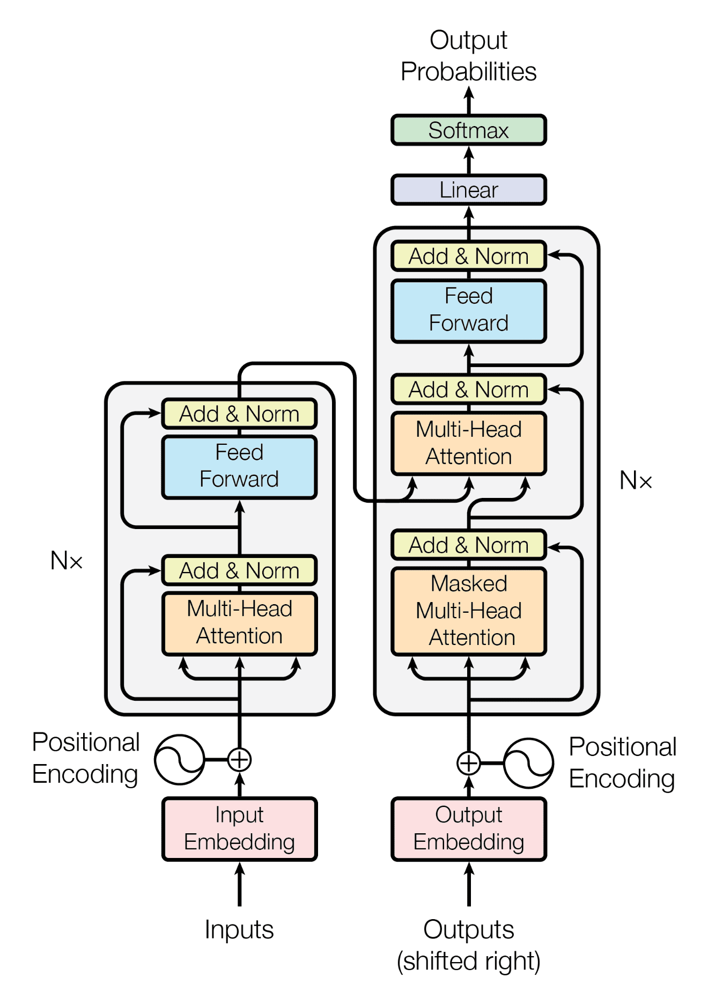
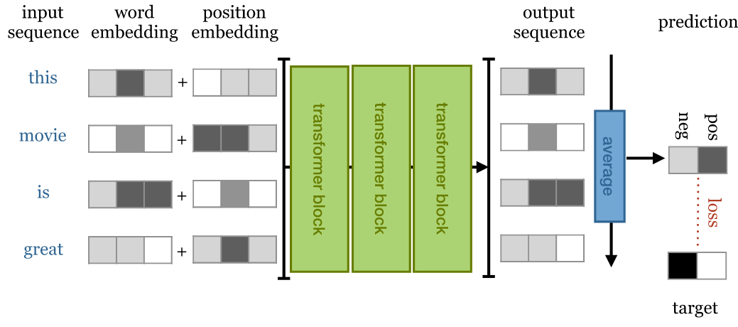
Hello Transformer
The moment everything changed. Yes, that big.
Key feature: contextualized embeddings (depends on context)
You’ve probably seen this before.

Slide 12
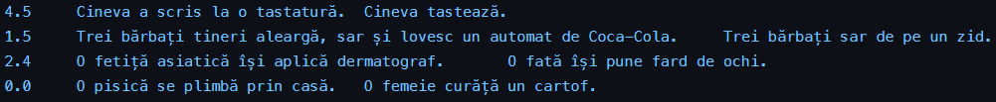
Let’s jump right in - Semantic Textual Similarity
What do we need to do?
What we’ll use:
A BERT model to encode our sentences
A single output (an 768*1 linear layer) on top that predicts a score
Transfer learning - when we take something pretrained (BERT) and repurpose it for our needs (RO-STS)

Slide 13
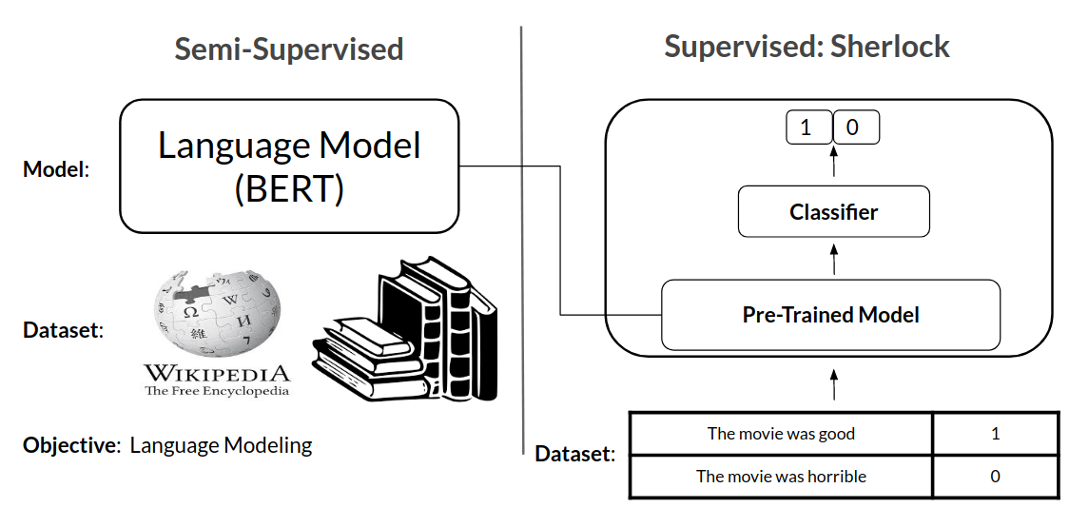
Just a slide about Transfer Learning

Slide 14
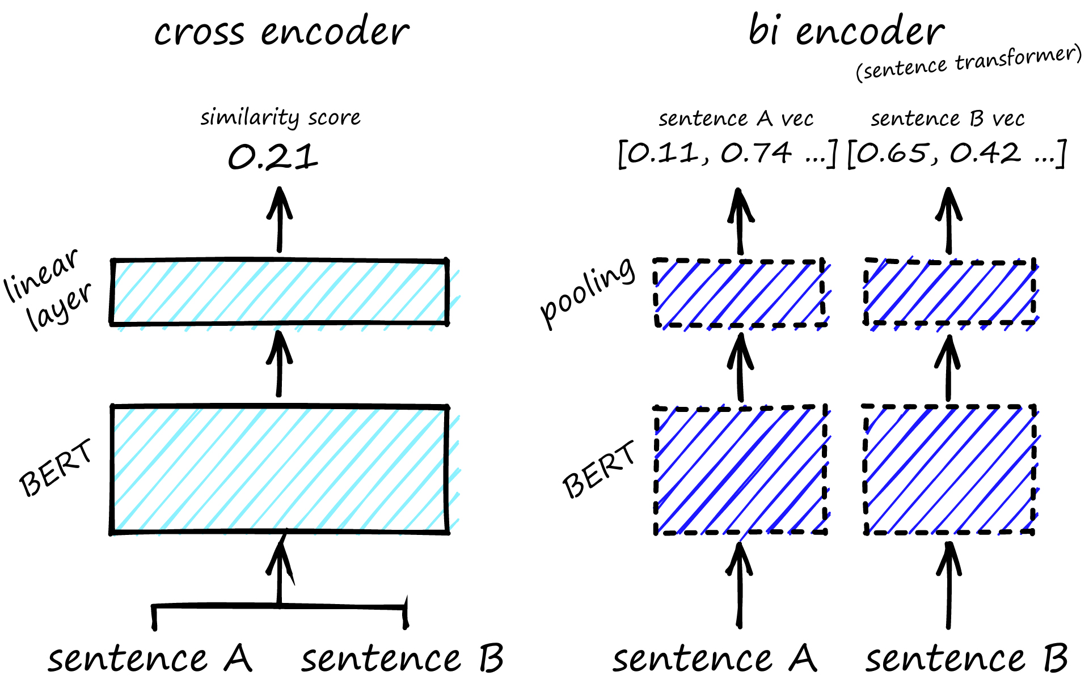

Slide 15
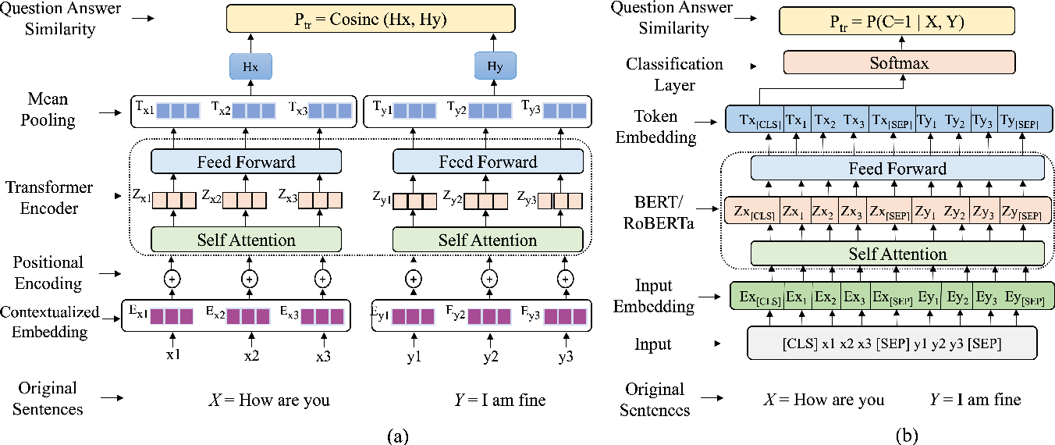
Bi Encoder
Cross Encoder

Slide 16
Coding time @
bit.ly/nitro-ws

